Slide 1
Multidimensional Data Visualization in iOS using Google Cardboard
Team 1
Ryan Bagby
Chad Brewer
Leonard Museau
Darren Williams

Slide 2
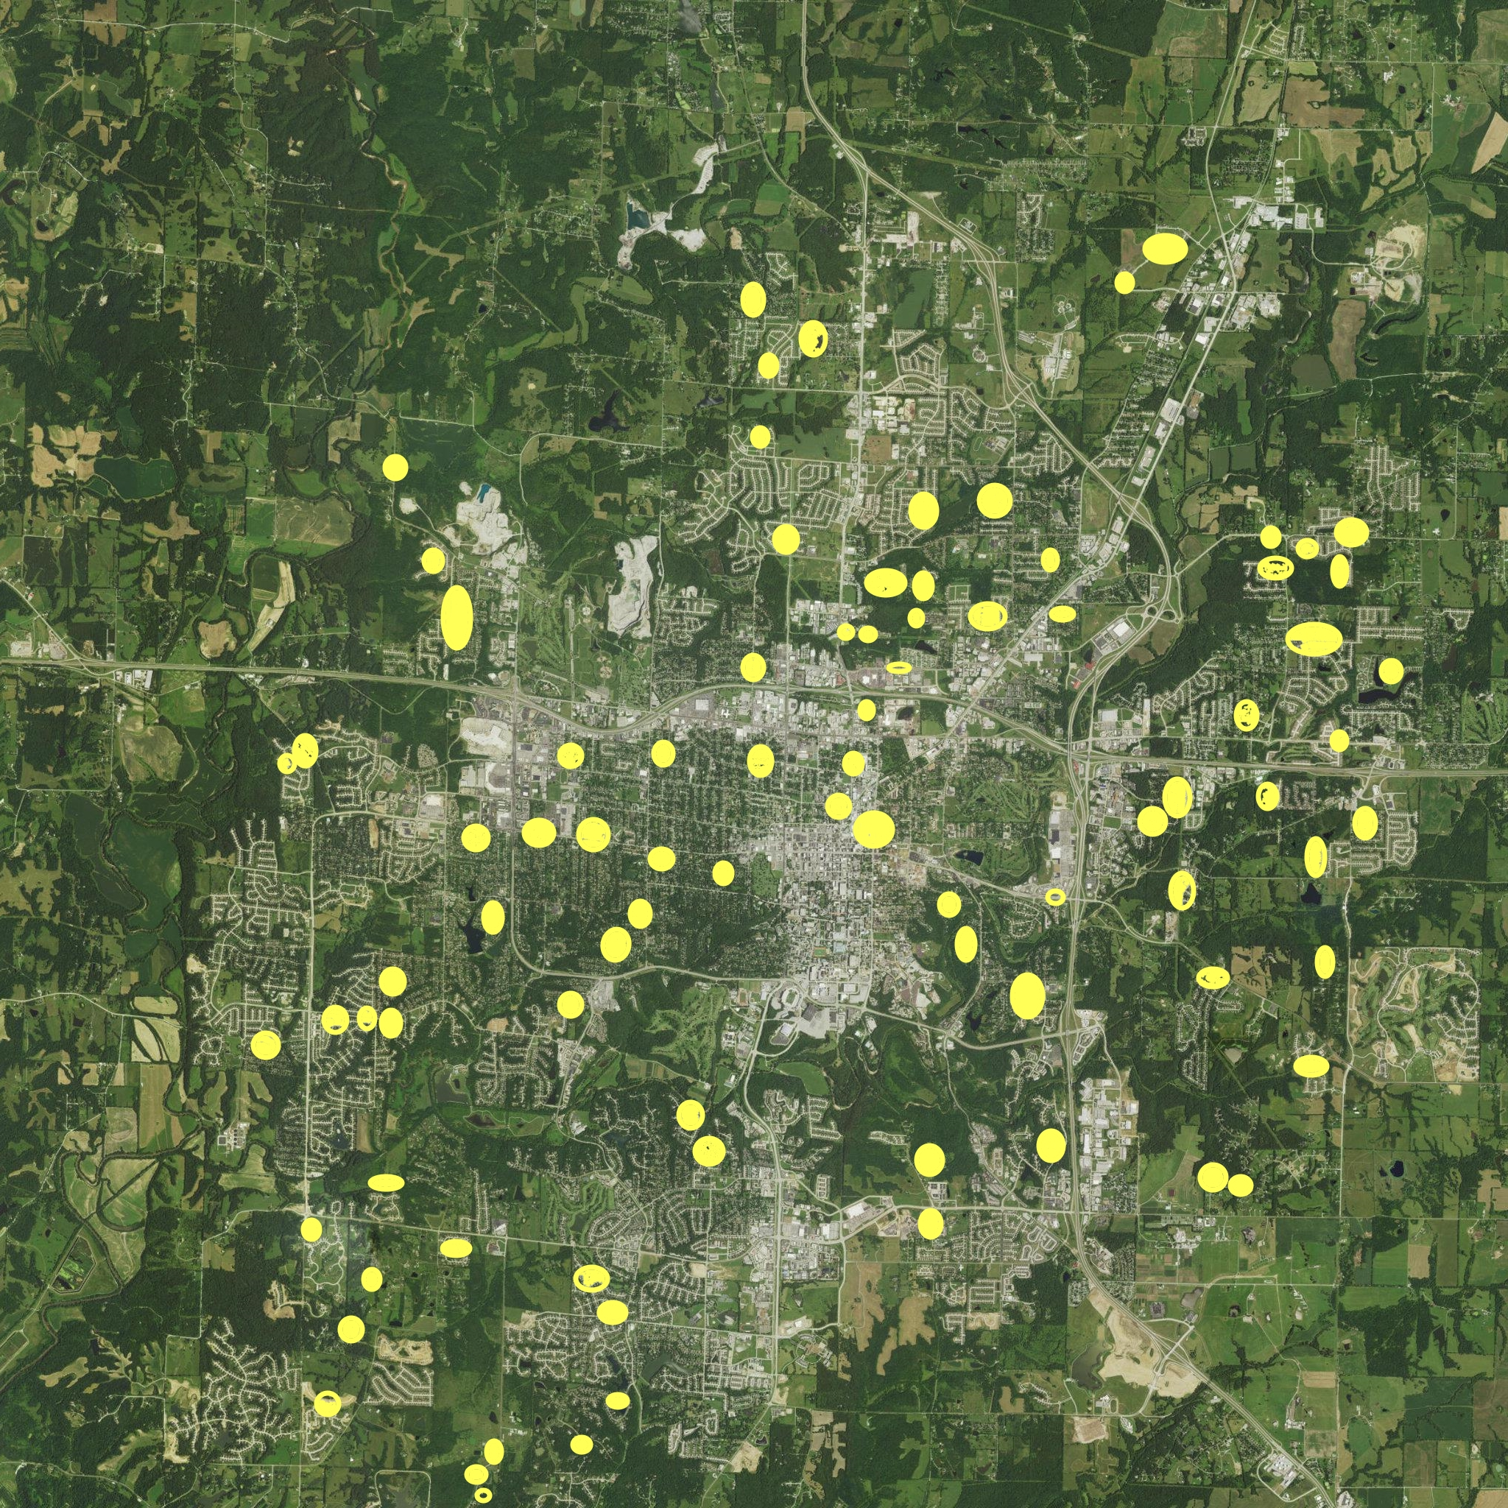
Project Overview
Using 3D technology to create an immersive environment for the user
Google Cardboard VR headset
Provide geographical and conservation data
Real geographical location in Missouri
Various birds that appear in the location

Slide 3
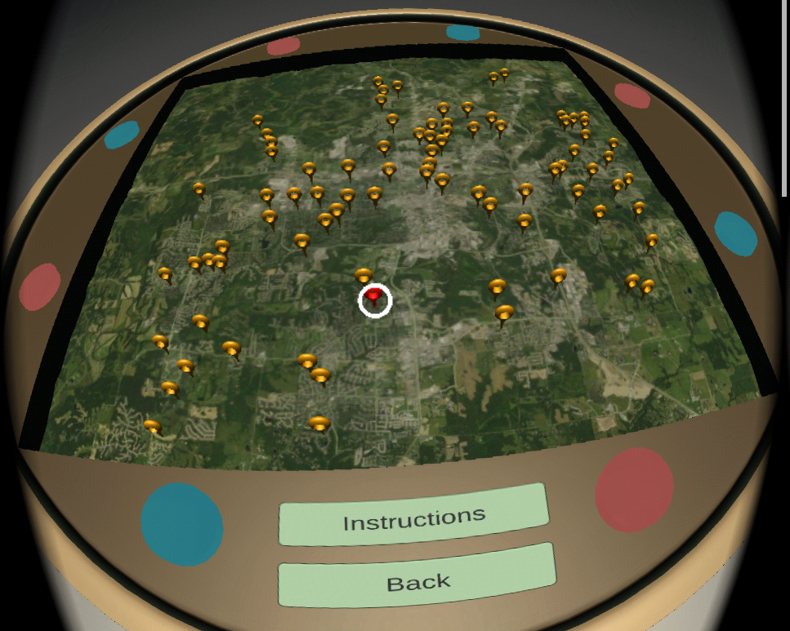
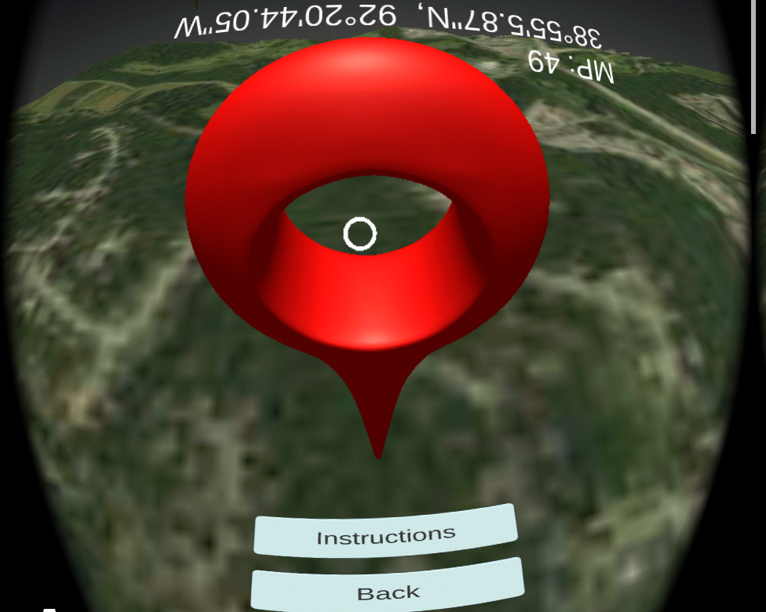
Background
Working off of previous CSC450 team code
Application originally created for Android OS
The team provided a basic 3D environment
No way to tell if in a forest or not
Can turn around but not a whole lot to the environment
Unity Game Engine
C#
Great documentation and tutorials
Can add to the environment with assets

Slide 4
Our Objectives
Port application to iOS
Add to the 3D environment
Give more realistic feel
Unity provides assets such as trees

Slide 5
Requirements
Functional Requirements
● Use Unity Game Engine to port from Android to iOS
● Remove outdated dependencies
● Implement error handling
● Utilize Unity's library of assets to add structures (trees, rocks, streams, etc.)

Slide 6
Non-Functional
The iOS application performance will be consistent with its Android counterpart.
● The implementation of added features and assets will be available on both iOS and Android.
● The application must operate with the same features reliably across both Android and iOS platforms.
● The code needs to be well documented.

Slide 7
Constraints
● The previous use of Gaze Click will not be able to be implemented due to licensing issues and will need to be purchased to continue its use.

Slide 8
Project Management
Trello
For tracking issues and progress we used Trello
Trello Board
Epics help organize Sprints more effectively

Slide 9
Estimation
Tracked inside of the Epics along with our Burndown Chart
Each Epic coincided with a sprint (2 weeks) Burndown Chart

Slide 10
Task Breakdown
Epics are broken down into smaller more manageable User Stories
User Stories can be broken down even further into tasks

Slide 11
Completed User Stories
Epic 1: Completed support for IOS
The app was originally designed for Android only.
Goal was to port the application into IOS as well.
Remove/Updated Dependencies

Slide 12
Completed User Stories
Epic 2: Added Immersion
Create a forest scene for viewing bird data in. (World View)
Add immersive sounds to the forest scene. (World View)
Replace current viewing scene with the forest scene. (World View)

Slide 13
Completed User Stories
Epic 3: Refactoring
Added sound to the Table View
Refactor Data Point Selection

Slide 14
What We Learned
Unity creates a “hidden” super class that ties in other classes
Monobehaviour
Scrum Process
Helped us with managing our time
Model View Controller Pattern
Observer Pattern

Slide 15
Future Plan
Maintain the application availability for iOS
GazeClick issues working on iOS
Alternatives?
Implement more features to give the environment some more immersion
Additional physical landmarks
Use map data to create actual 3D rendering of Missouri, other places
Greater variety of physical assets
Audio of specific bird calls
Be able to move around in the forest or scenes

